Slide 1
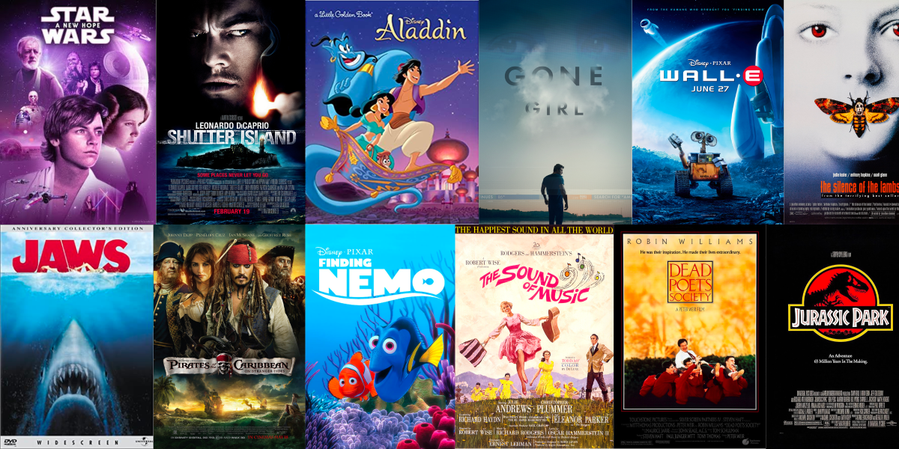
IMDB Movie Analysis

Slide 2
Project Description
The project involves assuming the role of a data analyst to grasp the statistics related to the IMDB rated movies. Using the fundamental statistical concepts, we'll manipulate the data to perform further analysis. Additionally, we'll explore how Excel functions can efficiently extract information essential for a data analyst's routine tasks. Teaching the practical application of these functions is the primary aim of this project.

Slide 3
The approach will be to perform the tasks in an organized way, creating separate sheets in the workbook for different tasks performed. The project analysis follows the below mentioned steps:
Approach
Step 1: Data Cleaning
Step 2: Genre Analysis
Step 3: Duration Analysis
Step 4: Language Analysis
Step 5: Director Analysis
Step 6: Budget Analysis

Slide 4

Tech-Stack Used
The analysis for this project has been performed using Microsoft Excel as it offers a user-friendly interface that allows users to work with data, perform calculations, and create visual representations without extensive programming knowledge.

Slide 5
Data Cleaning
Columns deleted
1 | Color
2 | num_critic_for_reviews
3 | director_facebook_likes
4 | actor_3_facebook_likes
5 | actor_2_name
6 | actor_1_facebook_likes
7 | actor_1_name
8 | num_voted_users
9 | cast_total_facebook_likes
10 | actor_3_name
11 | facenumber_in_poster
12 | plot_keywords
13 | movie_imdb_link
14 | num_user_for_reviews
15 | content_rating
16 | actor_2_facebook_likes
17 | aspect_ratio
18 | movie_facebook_likes
19 | country
20 | title_year
The steps involve:
duplicates removal
null values detection & imputation
outlier detection - removal/imputation
45 duplicate data points were removed
Columns not required for the analysis were removed
No columns were dropped due to high null values, threshold being 30%

Slide 6
Data Imputation – Language
English has been filled in the null cells due to the highest count

Slide 7
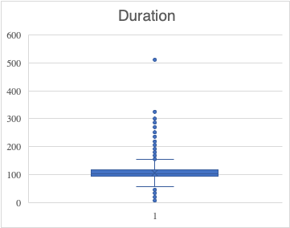
Data Imputation – Duration
Median value 103 is put in the null value cells
The data has outliers, so median values is chosen instead of other measures of central tendency
Outlier value is not replaced with median as movie with such duration is a possibility

Slide 8
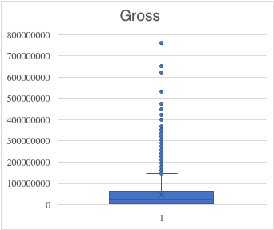
Data Imputation – Gross
Median value 25440971 is filled in the null value cells
The data has outliers, so median values is chosen instead of other measures of central tendency
Outlier values have not been replaced as extremes in revenue are possible

Slide 9
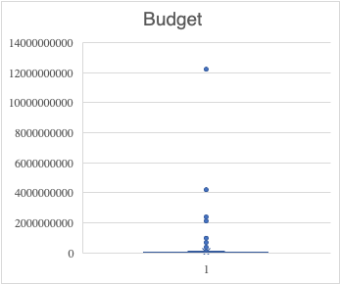
Data Imputation – Budget
Median value 20000000 is put in the null value cells
The data has outliers, so median values is chosen instead of other measures of central tendency
Outlier values have not been replaced as extremes in revenue are possible

Slide 10
Data Imputation – Director_name
103 records were deleted due to null value in director_name column
Imputation of director’s name is not an ideal choice

Slide 11
INSIGHTS

Slide 12
1. Most Commonly Produced Genres: Drama, Comedy, and Thriller are the most frequently produced genres in the film industry. 2. Highest IMDb Score: The highest IMDb score achieved by any movie belongs to the Comedy genre. 3. Average IMDb Ratings: Niche categories like Film Noir and News tend to receive the highest average IMDb ratings despite being less commonly produced. 4. Standard Deviation: These niche categories exhibit a relatively low standard deviation in their IMDb ratings. This low variability indicates a more consistent level of quality among these films, which is considered a positive indicator.
Genre | Count | Mean (imdb_score) | Median (imdb_score) | MODE (imdb_score) | Standard Deviation (imdb_score) | Variance (imdb_score) | Max (imdb_score) | Min (imdb_score)
Action | 1143 | 6.24 | 6.30 | 6.10 | 1.11 | 1.24 | 9.10 | 1.70
Adventure | 914 | 6.44 | 6.60 | 6.70 | 1.13 | 1.28 | 8.90 | 1.90
Animation | 242 | 6.58 | 6.70 | 6.70 | 1.14 | 1.30 | 8.60 | 1.70
Biography | 292 | 7.15 | 7.20 | 7.00 | 0.72 | 0.52 | 8.90 | 4.50
Comedy | 1862 | 6.19 | 6.30 | 6.70 | 1.09 | 1.19 | 9.50 | 1.70
Crime | 883 | 6.56 | 6.60 | 6.60 | 1.03 | 1.05 | 9.30 | 2.40
Documentary | 121 | 7.18 | 7.40 | 7.50 | 1.06 | 1.12 | 8.70 | 1.60
Drama | 2571 | 6.76 | 6.90 | 7.20 | 0.95 | 0.91 | 9.30 | 2.00
Family | 544 | 6.25 | 6.40 | 6.70 | 1.20 | 1.45 | 8.70 | 1.70
Fantasy | 604 | 6.31 | 6.40 | 6.70 | 1.16 | 1.34 | 8.90 | 1.70
Film-Noir | 6 | 7.63 | 7.65 | No mode found | 0.43 | 0.19 | 8.20 | 7.10
Game-Show | 1 | 2.90 | 2.90 | No mode found | 0.00 | 0.00 | 2.90 | 2.90
History | 205 | 7.08 | 7.20 | 7.50 | 0.89 | 0.79 | 8.90 | 2.00
Horror | 556 | 5.83 | 5.90 | 6.20 | 1.13 | 1.27 | 8.70 | 2.20
Music | 324 | 6.46 | 6.70 | 7.10 | 1.20 | 1.44 | 8.50 | 1.60
Musical | 132 | 6.51 | 6.70 | 7.00 | 1.23 | 1.50 | 8.50 | 2.10
Mystery | 493 | 6.49 | 6.60 | 6.60 | 1.08 | 1.17 | 8.60 | 2.20
News | 3 | 7.53 | 7.40 | No mode found | 0.51 | 0.26 | 8.10 | 7.10
Reality-TV | 2 | 4.75 | 4.75 | No mode found | 2.62 | 6.85 | 6.60 | 2.90
Romance | 1098 | 6.45 | 6.50 | 6.50 | 1.00 | 1.00 | 8.60 | 2.10
Sci-Fi | 611 | 6.28 | 6.40 | 6.70 | 1.21 | 1.46 | 8.80 | 1.90
Short | 5 | 6.38 | 6.50 | No mode found | 0.75 | 0.56 | 7.10 | 5.20
Sport | 181 | 6.60 | 6.80 | 7.20 | 1.10 | 1.22 | 8.70 | 2.00
Thriller | 1396 | 6.31 | 6.40 | 6.10 | 1.05 | 1.11 | 9.00 | 2.20
War | 211 | 7.07 | 7.10 | 7.10 | 0.88 | 0.77 | 8.60 | 2.70
Western | 94 | 6.70 | 6.80 | 6.50 | 1.06 | 1.11 | 8.90 | 3.80
Genre Analysis

Slide 13
Significance of Genre Analysis:
Audience preferences: Analyzing popular genres can reveal what types of stories or themes resonate with viewers. For instance, if action movies consistently rank high, it indicates a demand for adrenaline-packed narratives.
Trends and cycles: Understanding genre popularity over time can highlight industry shifts and cyclical trends. Certain genres may rise and fall in popularity depending on cultural factors or technological advancements.
Market segmentation: Studios use genre analysis to target specific audience demographics. For example, romantic comedies often cater to a different audience segment than horror films.

Slide 14
Duration | Count | Mean (imdb_score) | Median (imdb_score) | MODE (imdb_score) | Standard Deviation (imdb_score) | Variance (imdb_score) | Max (imdb_score) | Min (imdb_score)
178 | 8 | 6.43 | 6.35 | No mode found | 0.91 | 0.82 | 8.30 | 5.10
169 | 4 | 6.85 | 6.95 | No mode found | 1.63 | 2.66 | 8.30 | 5.20
148 | 11 | 6.59 | 7.30 | 7.70 | 1.35 | 1.82 | 7.80 | 3.50
164 | 4 | 6.70 | 6.70 | No mode found | 0.64 | 0.41 | 7.30 | 6.10
103 | 112 | 6.33 | 6.60 | 7.20 | 1.24 | 1.53 | 8.60 | 2.20
132 | 31 | 6.45 | 6.60 | 5.60 | 0.89 | 0.80 | 8.00 | 5.10
156 | 7 | 6.44 | 6.70 | 6.70 | 1.20 | 1.45 | 7.40 | 3.90
100 | 138 | 6.52 | 6.60 | 6.10 | 0.89 | 0.80 | 8.30 | 3.40
141 | 22 | 6.41 | 6.50 | 6.70 | 1.04 | 1.09 | 8.10 | 3.70
153 | 12 | 6.59 | 6.45 | No mode found | 1.59 | 2.52 | 8.80 | 3.70
183 | 2 | 6.85 | 6.85 | No mode found | 1.77 | 3.13 | 8.10 | 5.60
106 | 105 | 6.28 | 6.40 | 6.70 | 1.18 | 1.40 | 8.70 | 2.50
151 | 5 | 5.38 | 5.50 | 4.30 | 1.07 | 1.15 | 6.70 | 4.30
150 | 16 | 6.65 | 6.45 | 6.30 | 1.19 | 1.41 | 8.40 | 4.40
143 | 14 | 6.15 | 5.95 | 6.80 | 0.97 | 0.95 | 7.90 | 4.00
173 | 1 | 8.40 | 8.40 | No mode found | 0.00 | 0.00 | 8.40 | 8.40
136 | 23 | 6.37 | 6.50 | 6.30 | 1.13 | 1.28 | 8.40 | 3.90
186 | 3 | 6.63 | 7.00 | No mode found | 0.72 | 0.52 | 7.10 | 5.80
113 | 68 | 6.35 | 6.30 | 6.30 | 1.12 | 1.25 | 8.80 | 3.40
201 | 1 | 7.40 | 7.40 | No mode found | 0.00 | 0.00 | 7.40 | 7.40
194 | 2 | 7.60 | 7.60 | No mode found | 1.56 | 2.42 | 8.70 | 6.50
147 | 8 | 6.31 | 6.85 | 7.20 | 1.32 | 1.74 | 7.60 | 4.00
131 | 28 | 5.99 | 6.45 | 7.30 | 1.62 | 2.62 | 8.60 | 3.00
124 | 58 | 6.42 | 6.50 | 6.50 | 1.09 | 1.19 | 8.50 | 3.50
135 | 35 | 6.21 | 6.30 | 7.30 | 1.06 | 1.12 | 7.90 | 3.50
195 | 2 | 6.85 | 6.85 | No mode found | 0.64 | 0.40 | 7.30 | 6.40
108 | 89 | 6.51 | 6.60 | 7.30 | 0.96 | 0.92 | 8.00 | 3.10
104 | 100 | 6.33 | 6.40 | 6.40 | 1.07 | 1.15 | 8.50 | 3.60
165 | 5 | 5.58 | 5.40 | No mode found | 1.86 | 3.46 | 7.90 | 3.60
130 | 39 | 6.27 | 6.30 | 6.90 | 1.18 | 1.40 | 8.60 | 2.60
142 | 16 | 6.21 | 6.20 | 6.90 | 1.15 | 1.33 | 8.30 | 4.10
125 | 50 | 6.66 | 6.80 | 6.80 | 1.09 | 1.19 | 8.30 | 4.10
123 | 59 | 6.28 | 6.30 | 6.20 | 1.27 | 1.61 | 9.00 | 2.30
118 | 73 | 6.36 | 6.60 | 6.80 | 1.23 | 1.51 | 8.60 | 2.70
140 | 19 | 6.24 | 6.50 | 6.80 | 1.37 | 1.88 | 8.40 | 3.20
149 | 5 | 5.70 | 5.70 | No mode found | 0.61 | 0.38 | 6.60 | 4.90
114 | 66 | 6.04 | 6.00 | 6.60 | 1.17 | 1.38 | 8.60 | 3.40
116 | 65 | 5.98 | 6.00 | 5.40 | 1.16 | 1.34 | 8.30 | 2.70
154 | 11 | 6.45 | 6.70 | 6.70 | 0.99 | 0.99 | 8.40 | 4.60
122 | 54 | 6.07 | 6.15 | 6.20 | 1.17 | 1.36 | 8.70 | 3.50
93 | 125 | 6.45 | 6.70 | 6.80 | 1.19 | 1.41 | 8.30 | 1.70
Duration Analysis
Most Common Duration: Movies with a duration around 100 minutes are the most commonly produced.
Range of Movie Durations: The majority of movies fall within the range of 85 to 125 minutes in duration.
IMDb Ratings: Movies within this duration range tend to receive ratings near 6 on average.

Slide 15
Duration Analysis
Scatter Plot:
There seems to be a upward trend between the duration of a movie and its average IMDb ratings and the data points are widely spread.

Slide 16
Significance of Duration Analysis:
Audience attention span: Patterns in movie duration and IMDb ratings might suggest an optimal length that keeps audiences engaged without overwhelming or underwhelming them.
Genre-specific preferences: Certain genres might lend themselves to different durations. Action movies might have shorter optimal lengths compared to epic dramas.
Directorial style: Certain directors might have a signature duration for their films, which could influence audience expectations.

Slide 17
1. Commonly Produced Language: English is the most commonly used language for movie production. 2. Average IMDb Ratings: Despite being the most produced language, movies in English do not consistently achieve higher IMDb ratings on average. 3. Highest IMDb Ratings: The highest IMDb ratings are attained by movies in languages such as Telugu and Polish, surpassing the ratings of English language movies.
language | Count | Mean (imdb_score) | Median (imdb_score) | MODE (imdb_score) | Standar Deviation (imdb_score) | Variance (imdb_score) | Max (imdb_score) | Min (imdb_score)
English | 4662 | 6.40 | 6.50 | 6.70 | 1.12 | 1.26 | 9.50 | 1.60
Japanese | 17 | 7.35 | 7.50 | 8.20 | 1.00 | 1.00 | 8.70 | 5.60
French | 73 | 7.04 | 7.20 | 7.20 | 0.73 | 0.53 | 8.40 | 4.90
Mandarin | 24 | 6.79 | 7.05 | 7.60 | 1.04 | 1.08 | 7.90 | 3.20
Aboriginal | 2 | 6.95 | 6.95 | No mode found | 0.78 | 0.61 | 7.50 | 6.40
Spanish | 40 | 6.94 | 7.15 | 7.20 | 0.86 | 0.73 | 8.20 | 4.40
Filipino | 1 | 6.70 | 6.70 | No mode found | 0.00 | 0.00 | 6.70 | 6.70
Hindi | 28 | 6.63 | 6.95 | 7.80 | 1.40 | 1.96 | 8.50 | 2.80
Russian | 11 | 6.36 | 6.50 | 5.30 | 1.38 | 1.91 | 8.10 | 4.10
Maya | 1 | 7.80 | 7.80 | No mode found | 0.00 | 0.00 | 7.80 | 7.80
Kazakh | 1 | 6.00 | 6.00 | No mode found | 0.00 | 0.00 | 6.00 | 6.00
Telugu | 1 | 8.40 | 8.40 | No mode found | 0.00 | 0.00 | 8.40 | 8.40
Cantonese | 11 | 6.95 | 7.20 | 6.50 | 0.70 | 0.50 | 7.80 | 5.30
Icelandic | 2 | 7.55 | 7.55 | No mode found | 0.92 | 0.84 | 8.20 | 6.90
German | 19 | 7.34 | 7.60 | 7.40 | 0.95 | 0.91 | 8.50 | 4.90
Aramaic | 1 | 7.10 | 7.10 | No mode found | 0.00 | 0.00 | 7.10 | 7.10
Italian | 11 | 7.23 | 7.30 | No mode found | 1.24 | 1.55 | 8.90 | 5.10
Dutch | 4 | 7.43 | 7.45 | 7.80 | 0.43 | 0.19 | 7.80 | 7.00
Dari | 2 | 7.50 | 7.50 | No mode found | 0.14 | 0.02 | 7.60 | 7.40
Hebrew | 5 | 7.58 | 7.60 | No mode found | 0.33 | 0.11 | 8.00 | 7.20
Chinese | 3 | 5.67 | 5.70 | No mode found | 0.55 | 0.30 | 6.20 | 5.10
Mongolian | 1 | 7.30 | 7.30 | No mode found | 0.00 | 0.00 | 7.30 | 7.30
Swedish | 5 | 7.44 | 7.60 | No mode found | 0.76 | 0.57 | 8.20 | 6.60
Korean | 8 | 7.39 | 7.50 | 7.70 | 0.83 | 0.68 | 8.40 | 5.70
Thai | 3 | 6.63 | 6.60 | No mode found | 0.45 | 0.20 | 7.10 | 6.20
Polish | 4 | 8.25 | 8.25 | 9.10 | 0.98 | 0.96 | 9.10 | 7.40
Bosnian | 1 | 4.30 | 4.30 | No mode found | 0.00 | 0.00 | 4.30 | 4.30
None | 2 | 7.95 | 7.95 | No mode found | 0.78 | 0.61 | 8.50 | 7.40
Hungarian | 1 | 7.10 | 7.10 | No mode found | 0.00 | 0.00 | 7.10 | 7.10
Portuguese | 8 | 7.49 | 7.70 | No mode found | 0.88 | 0.78 | 8.70 | 6.10
Danish | 5 | 7.50 | 8.10 | 8.10 | 1.08 | 1.16 | 8.30 | 5.70
Arabic | 5 | 7.38 | 7.40 | No mode found | 0.88 | 0.78 | 8.20 | 6.00
Norwegian | 4 | 7.15 | 7.30 | 7.60 | 0.57 | 0.33 | 7.60 | 6.40
Czech | 1 | 7.40 | 7.40 | No mode found | 0.00 | 0.00 | 7.40 | 7.40
Kannada | 1 | 7.10 | 7.10 | No mode found | 0.00 | 0.00 | 7.10 | 7.10
Zulu | 2 | 7.10 | 7.10 | No mode found | 0.28 | 0.08 | 7.30 | 6.90
Panjabi | 1 | 6.60 | 6.60 | No mode found | 0.00 | 0.00 | 6.60 | 6.60
Tamil | 1 | 5.10 | 5.10 | No mode found | 0.00 | 0.00 | 5.10 | 5.10
Dzongkha | 1 | 7.50 | 7.50 | No mode found | 0.00 | 0.00 | 7.50 | 7.50
Vietnamese | 1 | 7.40 | 7.40 | No mode found | 0.00 | 0.00 | 7.40 | 7.40
Indonesian | 2 | 7.90 | 7.90 | No mode found | 0.42 | 0.18 | 8.20 | 7.60
Urdu | 1 | 7.00 | 7.00 | No mode found | 0.00 | 0.00 | 7.00 | 7.00
Romanian | 2 | 7.20 | 7.20 | No mode found | 0.99 | 0.98 | 7.90 | 6.50
Persian | 4 | 7.58 | 7.95 | No mode found | 1.20 | 1.45 | 8.50 | 5.90
Slovenian | 1 | 6.40 | 6.40 | No mode found | 0.00 | 0.00 | 6.40 | 6.40
Greek | 1 | 7.30 | 7.30 | No mode found | 0.00 | 0.00 | 7.30 | 7.30
Swahili | 1 | 7.40 | 7.40 | No mode found | 0.00 | 0.00 | 7.40 | 7.40
Language Analysis

Slide 18
Significance of Language Analysis:
Global appeal: Analyzing the predominant languages in highly-rated movies can provide insights into their international success. Movies in widely spoken languages might have broader global audiences.
Cultural influences: The language used in a film can indicate its cultural context and intended audience. Subtle nuances or linguistic choices might impact how a movie is received in different regions.

Slide 19
Director Analysis
Top 1% directors based on 99th percentile
Top 1% directors | Mean (imdb_score)
Christopher Nolan | 8.4
S.S. Rajamouli | 8.4
Moustapha Akkad | 8.4
Richard Marquand | 8.4
Sergio Leone | 8.5
Catherine Owens | 8.4
John Blanchard | 9.5
Rakeysh Omprakash Mehra | 8.4
Mike Mayhall | 8.6
Raja Menon | 8.5
Ron Fricke | 8.5
Jay Oliva | 8.4
Damien Chazelle | 8.5
Robert Mulligan | 8.4
Mitchell Altieri | 8.7
Charles Chaplin | 8.6
Sadyk Sher-Niyaz | 8.7
Asghar Farhadi | 8.4
Marius A. Markevicius | 8.4
Majid Majidi | 8.5
Cary Bell | 8.7
Bill Melendez | 8.4
99th Percentile is 8.3
These directors represent the top 1% in terms of IMDb scores, showcasing their exceptional achievement in consistently receiving high ratings for their work in the film industry.

Slide 20
Significance of Director Analysis:
Auteur theory: Examining the works of specific directors can reveal recurring themes, stylistic choices, or storytelling techniques unique to their vision.
Consistency in quality: Directors with consistently high-rated movies may have a strong influence on a film's success, indicating a loyal fan base or a distinct directorial style.
Evolution of style: Tracking a director's filmography over time can show how their style, storytelling, or choice of genres has evolved, impacting audience reception.

Slide 21
Budget Analysis
The data set is normally distributed.
A nearly equal number of movies have made a profit and an equivalent number have incurred losses.

Slide 22
Budget Analysis
Top performing movies (Profit Margin) | Genre
Avatar | Action|Adventure|Fantasy|Sci-Fi
Jurassic World | Action|Adventure|Sci-Fi|Thriller
Titanic | Drama|Romance
Star Wars: Episode IV - A New Hope | Action|Adventure|Fantasy|Sci-Fi
E.T. the Extra-Terrestrial | Family|Sci-Fi
The Avengers | Action|Adventure|Sci-Fi
The Lion King | Adventure|Animation|Drama|Family|Musical
Star Wars: Episode I - The Phantom Menace | Action|Adventure|Fantasy|Sci-Fi
The Dark Knight | Action|Crime|Drama|Thriller
The Hunger Games | Adventure|Drama|Sci-Fi|Thriller
Most of the top 10 highest-profit movies belong to the action and adventure genres, which also represent the genres with the highest production count.

Slide 23
Budget Analysis
Lowest performing movies | Genre
The Host | Action|Adventure|Romance|Sci-Fi|Thriller
Lady Vengeance | Crime|Drama
Fateless | Drama|Romance|War
Princess Mononoke | Adventure|Animation|Fantasy
Steamboy | Action|Adventure|Animation|Family|Sci-Fi|Thriller
Akira | Action|Animation|Sci-Fi
Godzilla 2000 | Action|Adventure|Drama|Sci-Fi|Thriller
Tango | Drama|Musical
Kabhi Alvida Naa Kehna | Drama
Kites | Action|Drama|Romance|Thriller
No specific genre trend can be identified among the movies, as many of them also belong to the action and adventure genres.

Slide 24
Significance of Budget Analysis:
Return on Investment (ROI): Comparing budgets against IMDB ratings can reveal if higher budgets consistently translate to higher ratings or if smaller-budget films can compete in terms of quality.
Production value: Budget analysis can highlight how effectively resources are utilized. It can show if a high budget correlates with better visual effects, star power, or overall production quality.
Industry benchmarks: Understanding budget trends can help studios benchmark their investments against successful movies in similar genres or with similar ratings.

Slide 25
Excel Link
https://docs.google.com/spreadsheets/d/1Pn74y-pIPuyTGPwyWftH45fIlZtfvPCL/edit?usp=sharing&ouid=101949921485202693908&rtpof=true&sd=true
Video link
https://www.loom.com/share/6041f197c2214bf68ee8f0384da52998?sid=49b3889f-315b-4927-b96d-844cdb81b5ac

